Slide 1

DATA - ANALYSIS FOR CUSTOMER ACTIVATION & RETENTION

Slide 2
HELLO!
I am ArunKumar Muruganandam.
I have done this project to understand the customer
retention strategies in the E-commerce industry.
You can find me at @ er.arunalpha@gmail.com and in
https://github.com/ArunAlpha-data

Slide 3
TABLE OF CONTENTS
Introduction
1. What is Customer Retention?
2. Why is customer retention important?
3. Customer retention benefits.
4. E-Commerce websites and Customer Retention.
5. Review of Literature.
Analytics of Customer Retention
1. What is Analytical problem framing?
2. Hardware Requirements.
3. Software Requirements.
4. Tools, Libraries and Packages used.
5. Data Pre-Processing.
6. Exploratory Data-Analysis.
Conclusion

Slide 4
INTRODUCTION
Let’s start the Data-Analysis.

Slide 5
What is Customer Retention?
Customer retention refers to a company’s ability to turn
customers into repeat buyers and prevent them from switching
to a competitor. It indicates whether your product and the
quality of your service please your existing customers. It’s also
the lifeblood of most subscription-based companies and service
providers.
Customer retention strategies are the processes and
initiatives businesses put in place to build customer loyalty and
improve customer lifetime value.

Slide 6
2. Why is customer retention important?
Keeping your current customers happy is generally more
cost-effective than acquiring first-time customers. According to
the Harvard Business Review, acquiring a new customer can be
5 to 25 times more expensive than holding on to an existing one.
You don’t need to spend big on marketing, advertising, or
sales outreach. It is easier to turn existing customers into
repeating ones, since they already trust your brand from
previous purchases. New customers, however, often require
more convincing when it comes to that initial sale.
Customer loyalty won’t just give you repeat business.
Loyal customers are more likely to give free recommendations
to their colleagues, friends, and family. Creating that cycle of
retained customers and buzz marketing is one way your
company can cultivate customer loyalty for long-term success.

Slide 7
3. Customer retention benefits
1.Cost savings: Customer retention is generally more costeffective
than acquiring first-time customers.
•2.Positive word of mouth marketing: Loyal customers are
more likely to tell their friends and family about your
brand.
3. A better bottom line: Increasing retention rates by just 5
percent can increase revenue by 25 percent to 95 percent.

Slide 8
4. E-Commerce websites and Customer Retention
For an e-commerce store, the customer retention rate is directly
related to how much your customers trust you and how much
they relish the experience of spending time on your
website/app.
1.Trust.
2.Aesthetics.
3.Ease of use.
4.Clarity

Slide 9
5. Data Pre- Processing
For understanding the factors influencing the customer
retention, we should consider 4 important variables.
These 4 variables manipulate the 'customer satisfaction',
which in turn makes the customer to stay.
These variables are:
1. Hedonic Value.
2. Utilitarian Value.
3. Precieved Risk.
4. Customer Experience.
By Analysing on the basis of these variables, we can find
the basic factors influencing the 'customer satisfaction’. Thus, by
achieving the 'customer satisfaction' we can make the customer
to stay and make them buy more products.
So we will do the following Analysis in 5 parts. We will use
different parts of the given data-set to help us find the customer
retention factors.

Slide 10
Exploratory Data-Analysis

Slide 11
We will divide the given data
1.Part-1 will be informaiton about the cutomer.
2.Part-2 will be Utilitarian Value.
3.Part-3 will be Hedonic Value.
4.Part-4 will be Precieved Risk.
5.Part-5 will be Customer Experience.

Slide 12
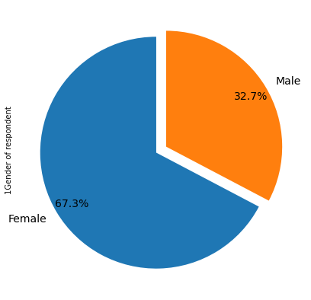
PART-1
CUSTOMER INFORMATION
1. Visualising the Gender of respondent
Female 181
Male 88
Name: 1Gender of respondent

Slide 13
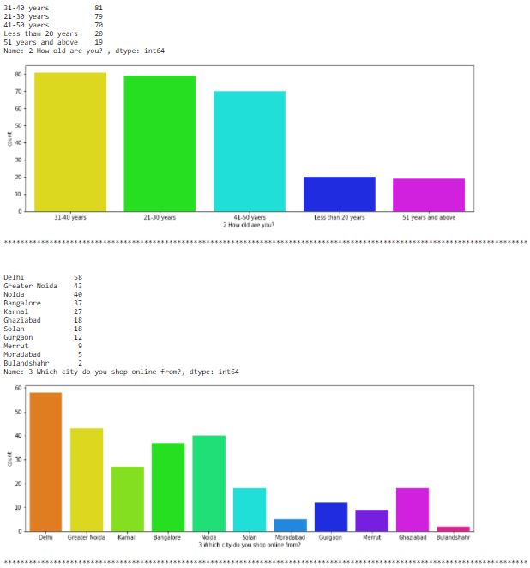

Slide 14
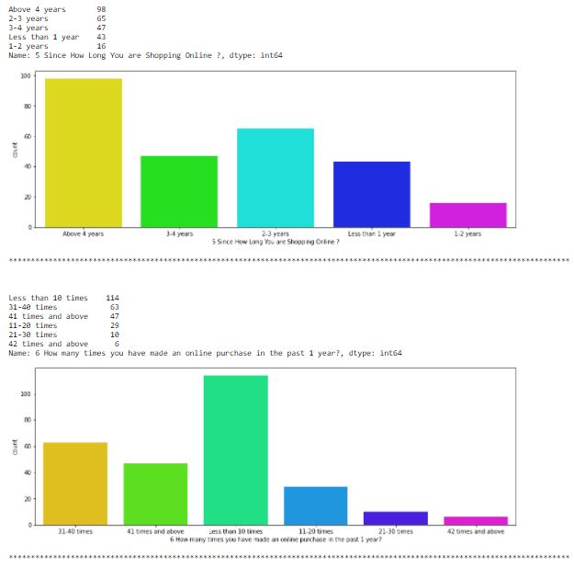

Slide 15
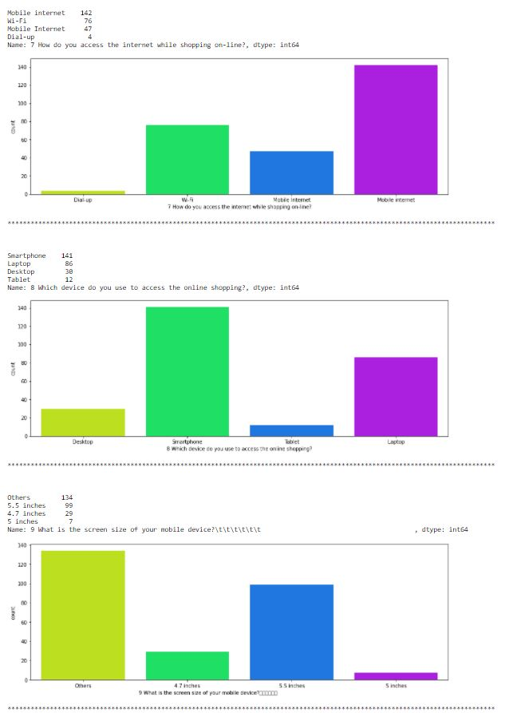

Slide 16
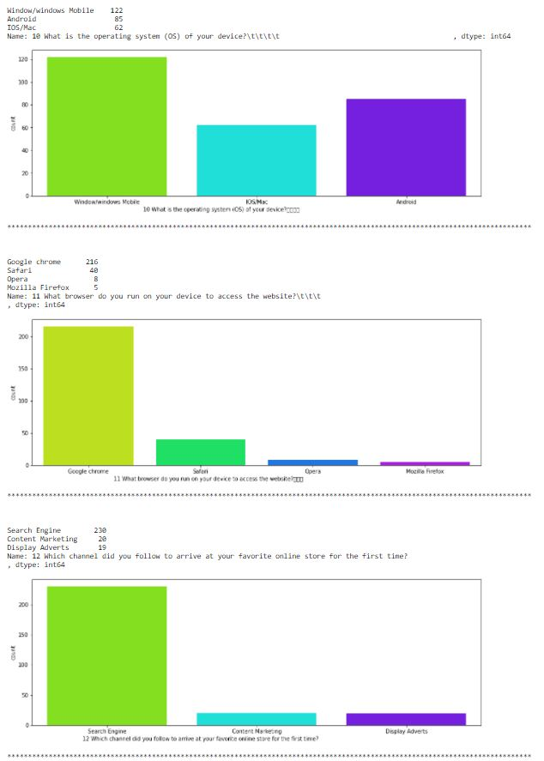

Slide 17
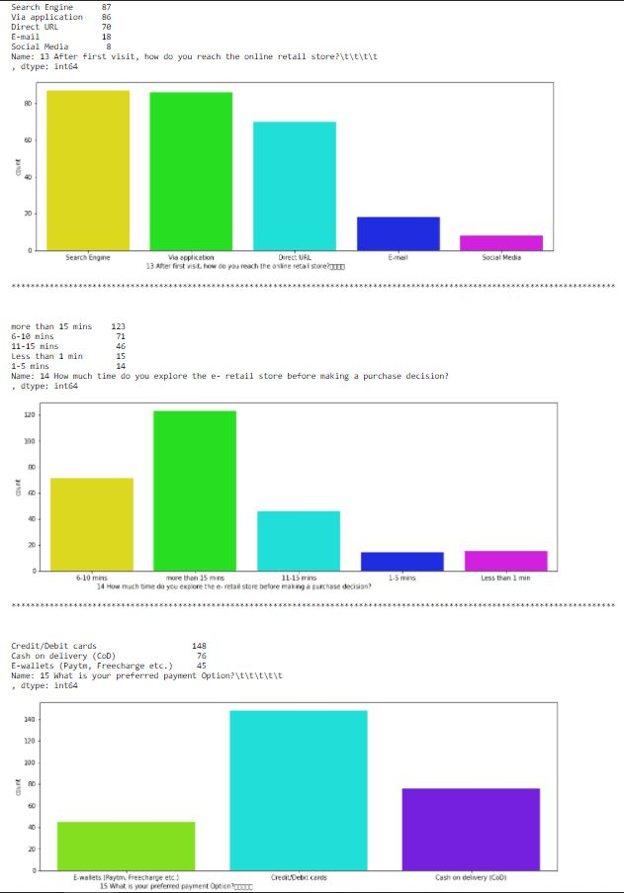

Slide 18
OBSERVATION ON CUSTOMER INFO:
1. Out of the entire participant around 67.3 %( 181 members) are women and 32.7 %( 88 members) are men.
2. 80% (230 members) of the total participants are between the age group of 21-50 years, in which 21-30 years are 79 members, 31-40 years are 81 members and 41-50 years are 70 members.
3. Participants from Delhi, Noida, Greater Noida and Bangalore seem to be shopping in higher range when considered to other cities included for the survey. This may be due to the fact that many companies and colleges are around this area.
4. Around 65% of the total participants are shopping online for more than 3 years.
5. Major part of the customers seems to be shopping less than 10 times a year.
6. Most of the customers seem to be using Smart Phone and Mobile Internet for shopping. This means the E-commerce website should be compatible in all kinds of smart phone browsers to attract a lot more customers.
7. Many used search engine to find their favorite online store, which means the E-commerce website should be search engine optimized on all times.
8. Also after the search engine, E-commerce application seems to be the second favorite mode of logging in to the website. This means the application should be server and software supported at all times.
9. Most of the participants seem to be spending an average of more than 15mins in the website for shopping.
10. Most participants desire to pay via Credit/ Debit cards while shopping online.

Slide 19
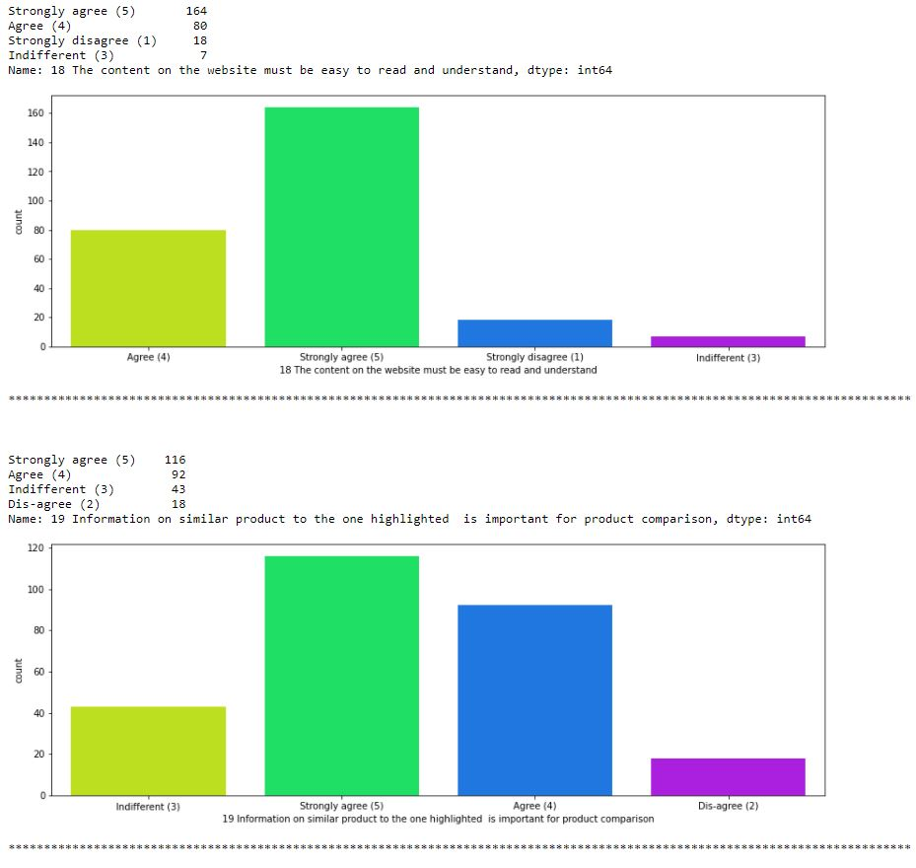
PART-2: UTILITARIAN VALUE

Slide 20
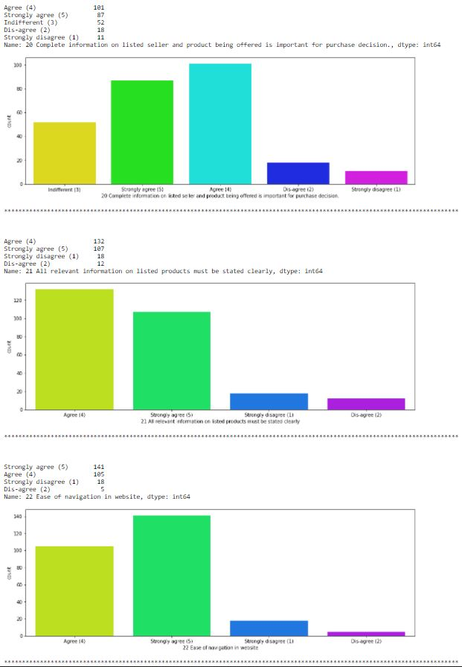

Slide 21
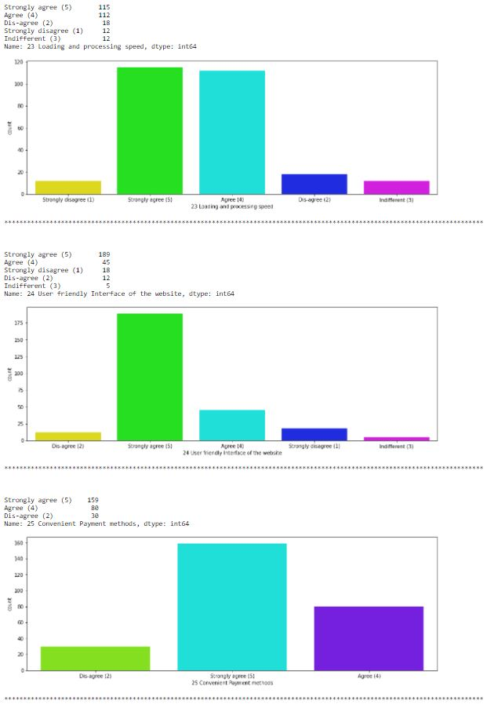

Slide 22
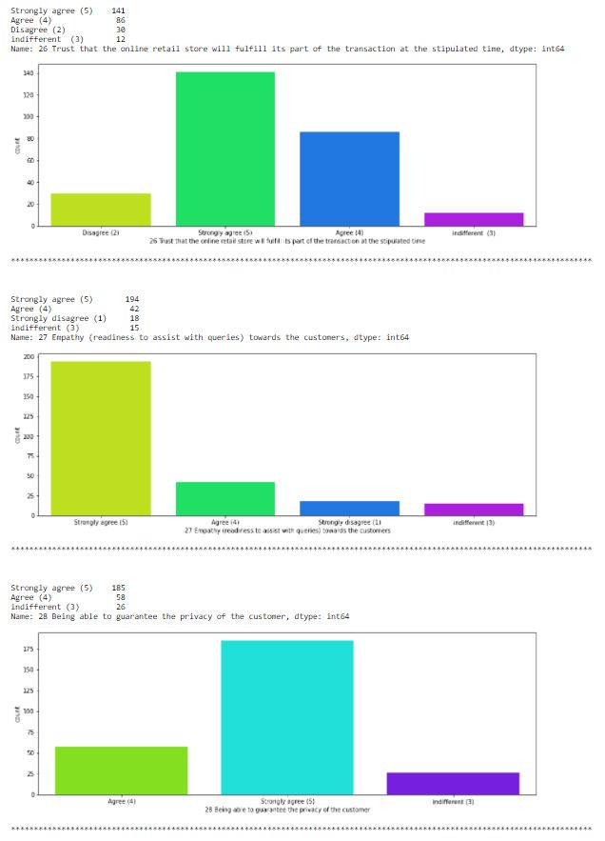

Slide 23
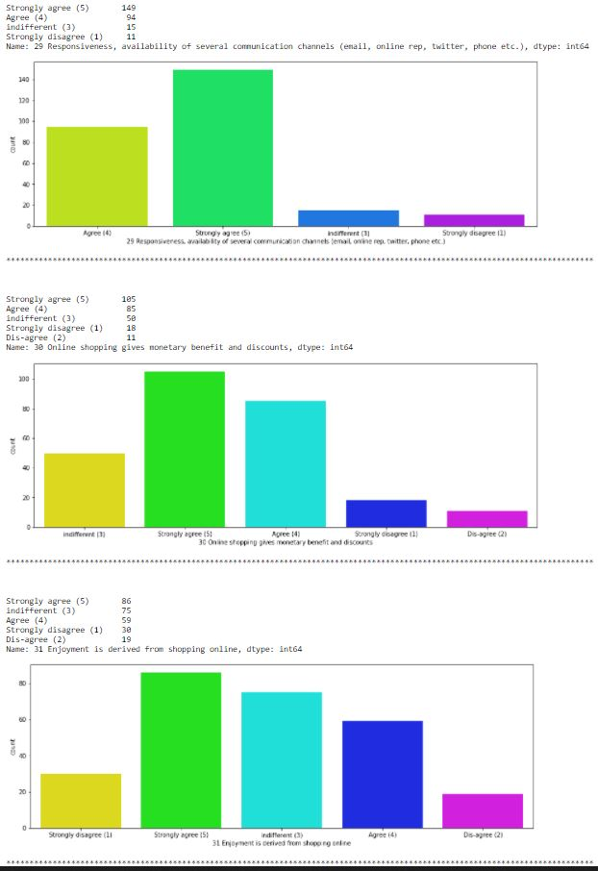

Slide 24
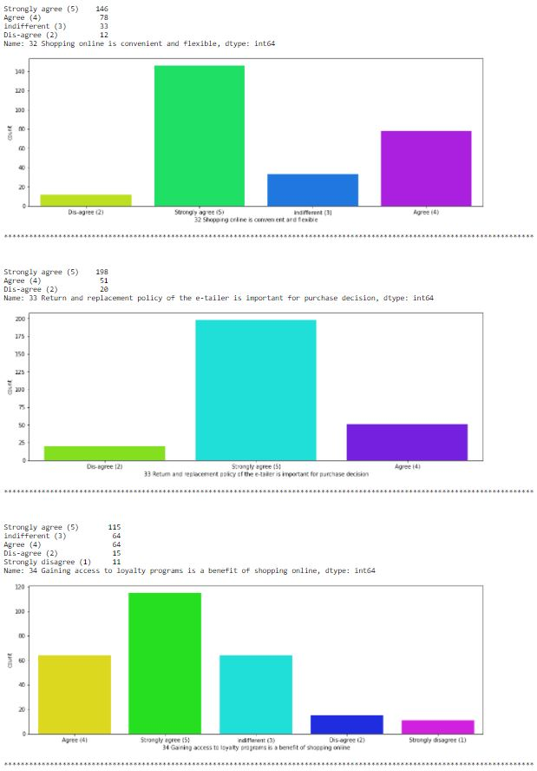

Slide 25
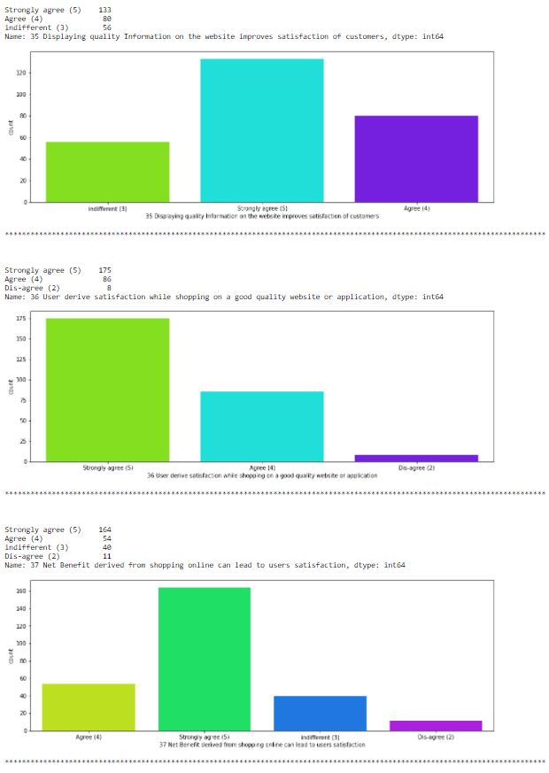

Slide 27
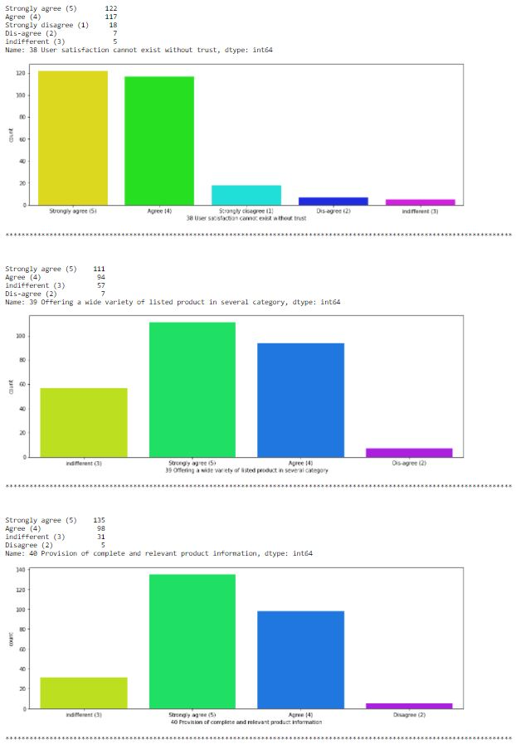

Slide 28
OBSERVATION ON UTILITARIAN VALUES:
1. Most of the participants strongly agree that the content on the website must be easy to read and understand.
2. Around 80% of the total customer strongly agrees that the information on similar product to the one highlighted is important for product comparison.
3. Most of the participants agree with the fact that provision of complete information on listed seller and product being offered is important for purchase decision.
4. Most of the customers expect that all relevant information on listed products must be stated clearly.
5. 90% of the customer expects a user friendly interface of the website along with ease of navigation; also they want the loading and processing speed to be less.
6. Most customers want many options for payment methods so thatthey can choose which is convenient them individually.
7. Most people expect the E-commerce website to have empathy towards its customers, they want to approach the in all platforms.
8. All the customers expect a guaranteed privacy.
9. Most customers choose online shopping because of the monetary benefit and discounts.
10. Also many enjoy the process of online shopping, when it is convenient and flexible.
11. Most customers strongly agree that return and replacement policy of the product is important for purchase decision.
12. Around 80% of the participants choose online shopping because of the wide range of category on products

Slide 29
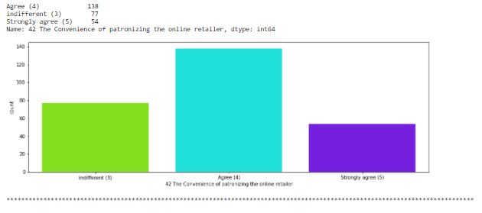
PART-3 : HEDONIC VALUE

Slide 30
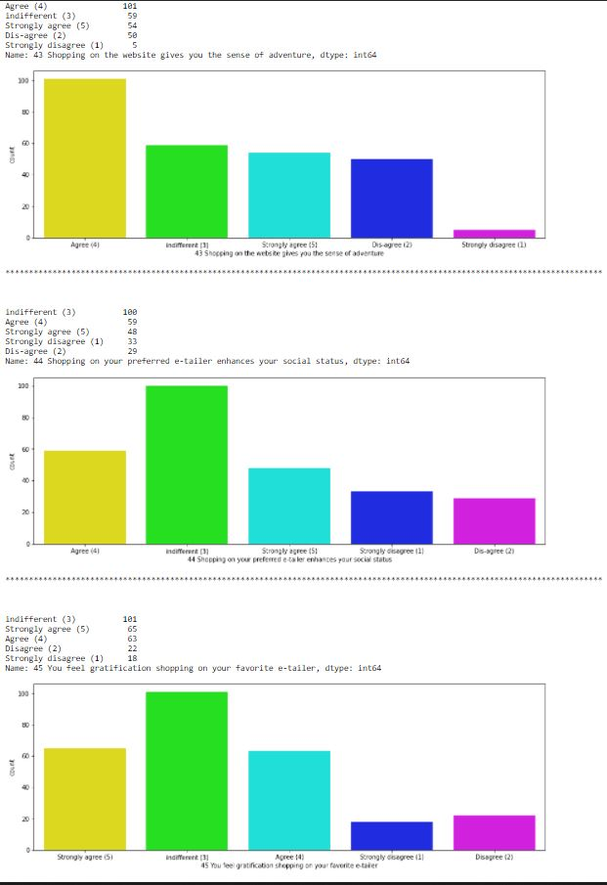

Slide 31
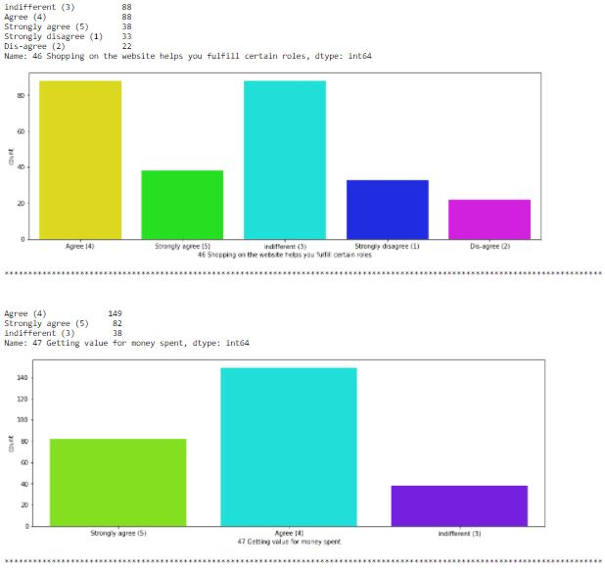

Slide 32
OBSERVATION ON HEDONIC VALUES:
1. 65% participants agree that they like the convenience of patronizing the online retailer.
2. More than half of the customers doing online shopping accept that they like the sense of adventure while shopping online.
3. Many customers don’t agree that shopping on their preferred website enhances their social status.
4. Half of the total participants say that shopping on the website helps them fulfill certain roles.
5. 90% of the customer agrees that they are getting value for money spent while shopping online.

Slide 33
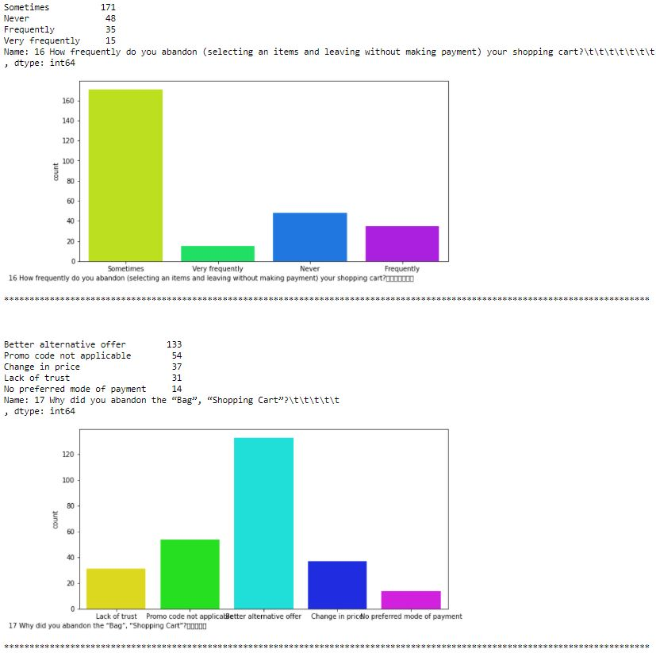
PART-4: PRECIEVED RISK
OBSERVATION ON PRECIEVED RISK:
1. Many people abandon their shopping cart due to factors such as better alternative offer, promo code not applicable, change in price, lack of trust, and no preferred mode of
payment.

Slide 34
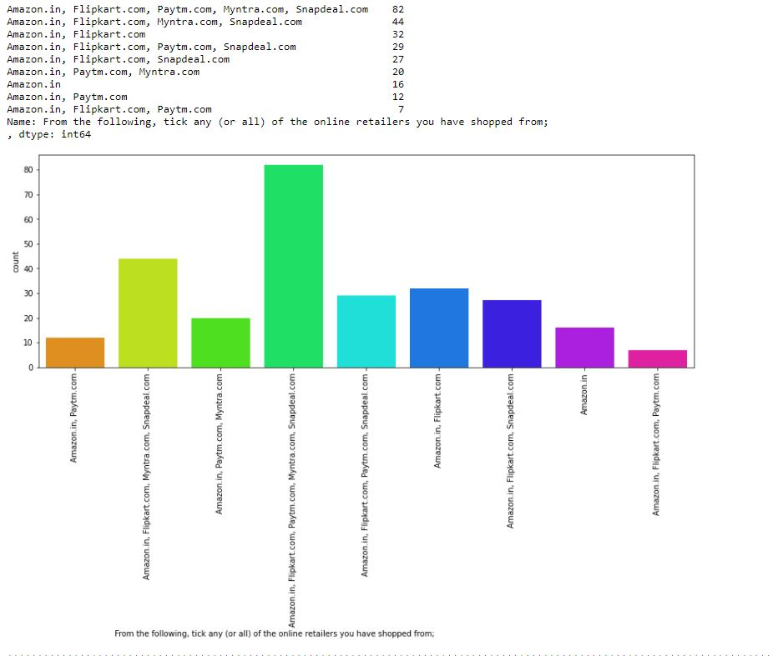
PART-5: CUSTOMER EXPERIENCE

Slide 35
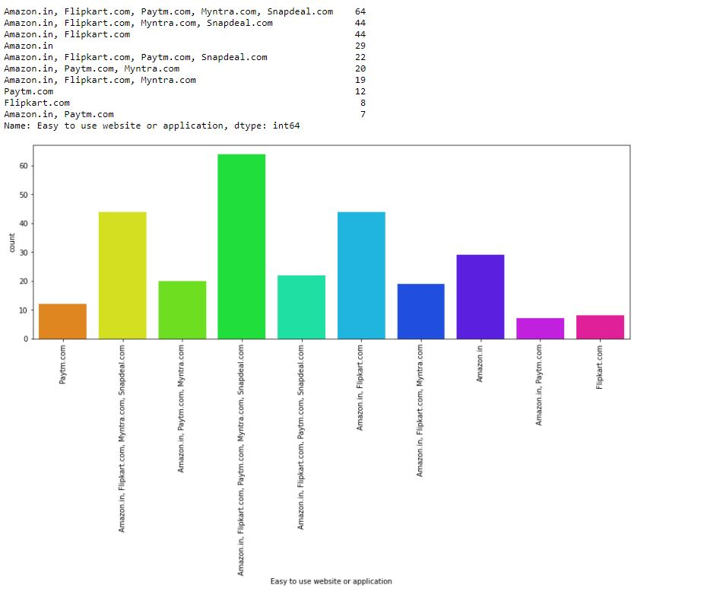

Slide 36
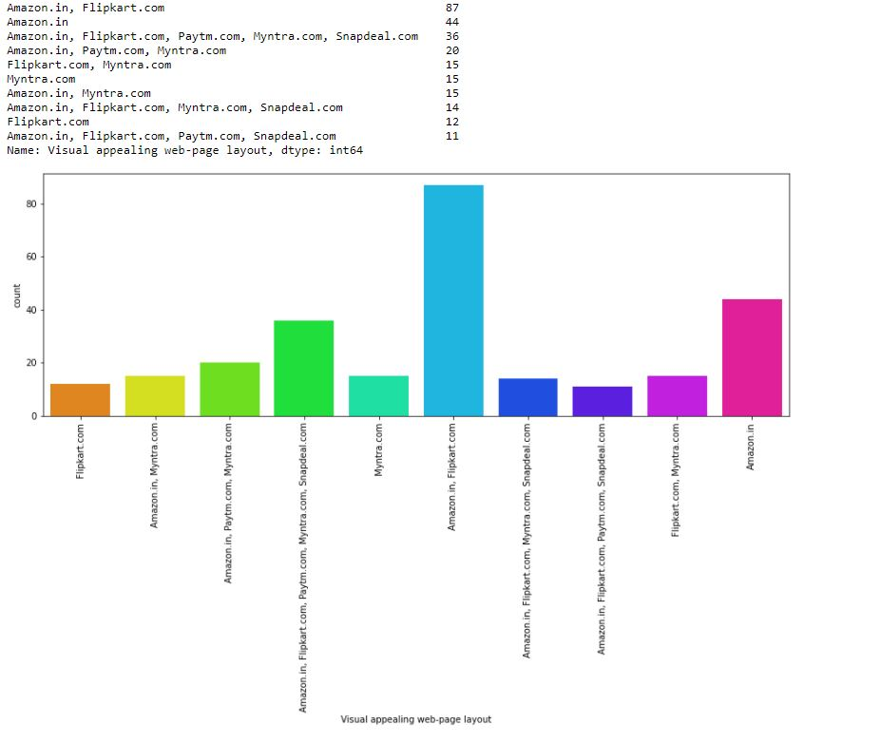

Slide 37
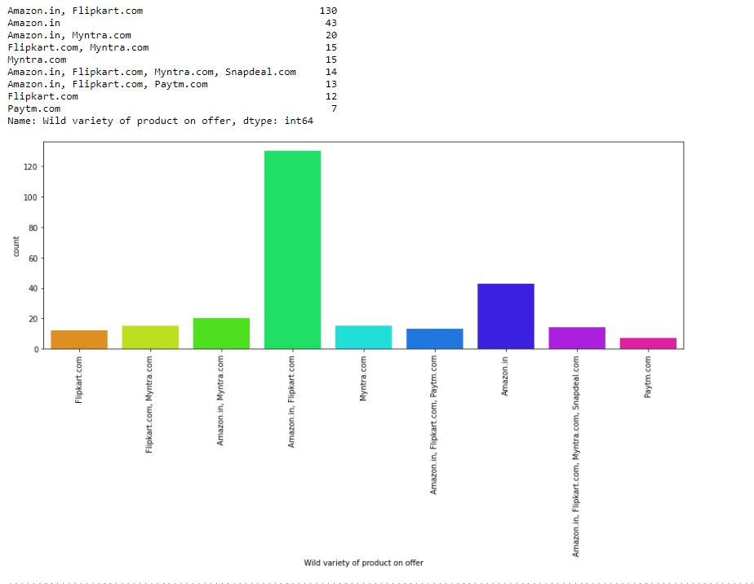

Slide 38
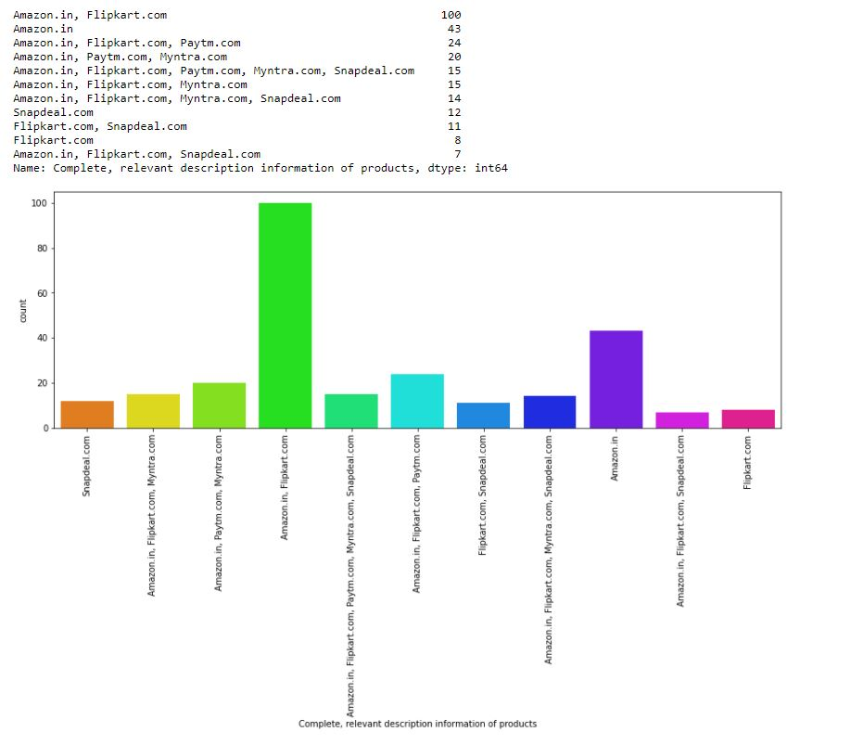

Slide 39
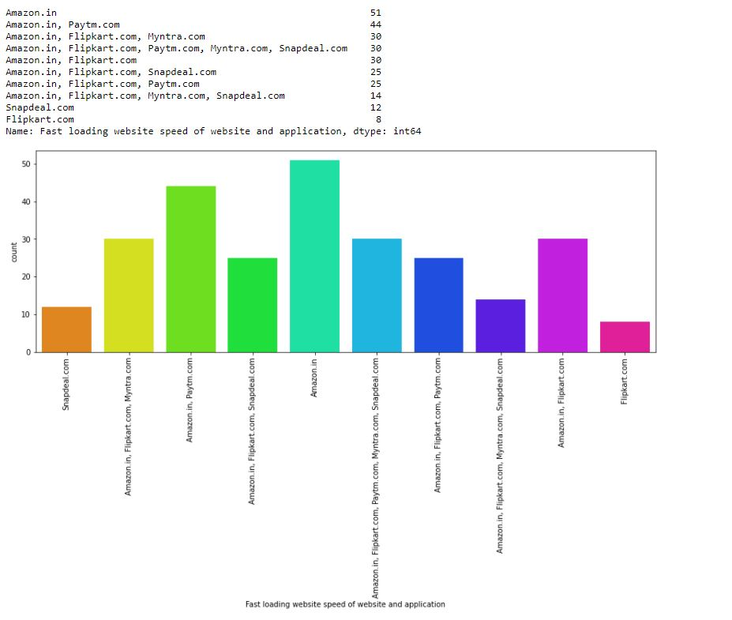

Slide 40
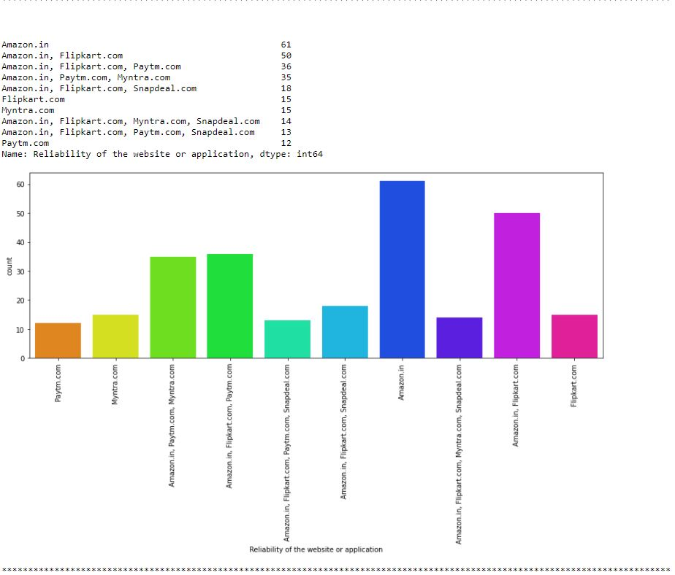

Slide 41
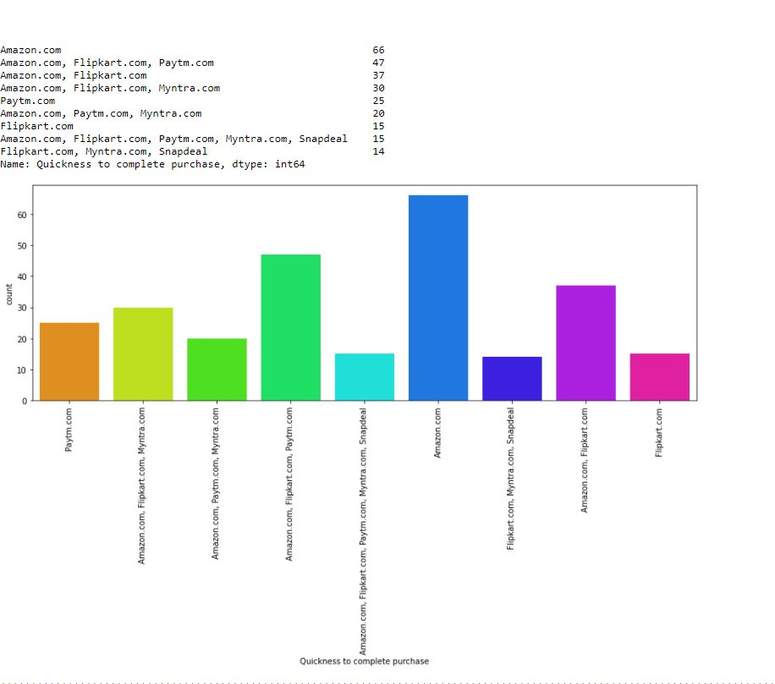

Slide 42
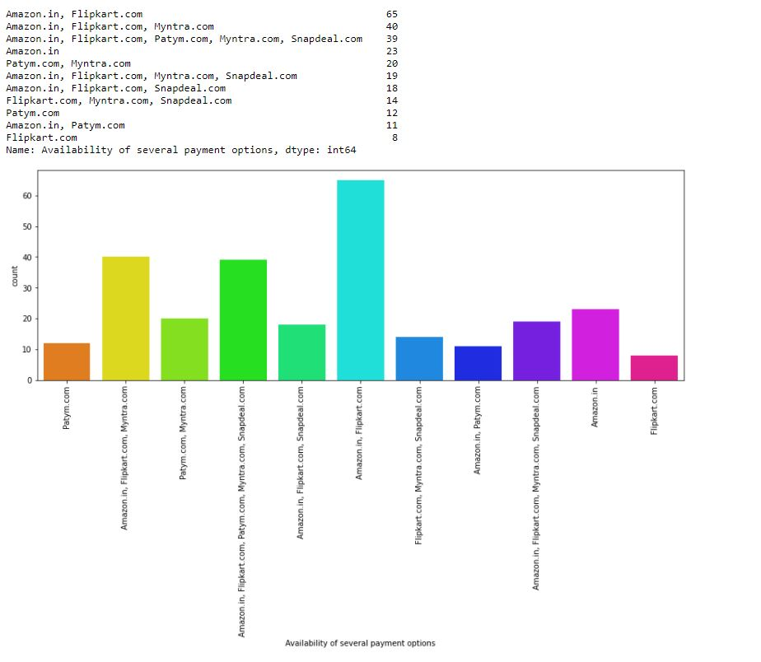

Slide 43
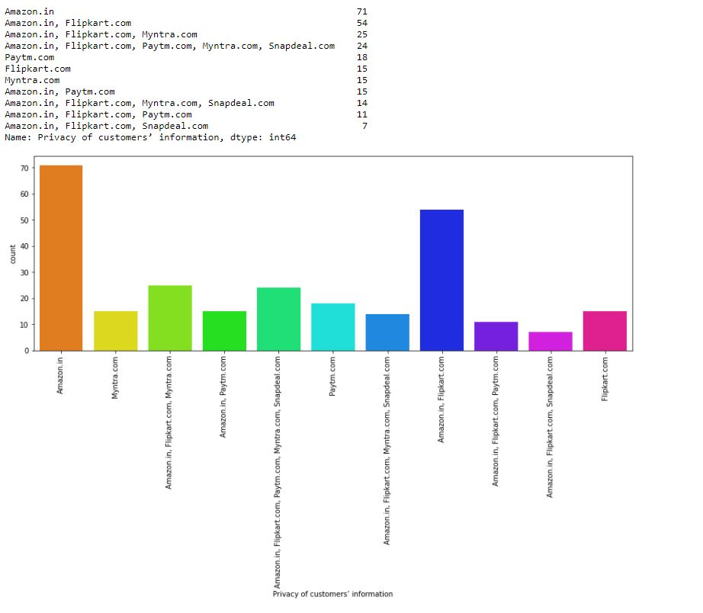

Slide 44
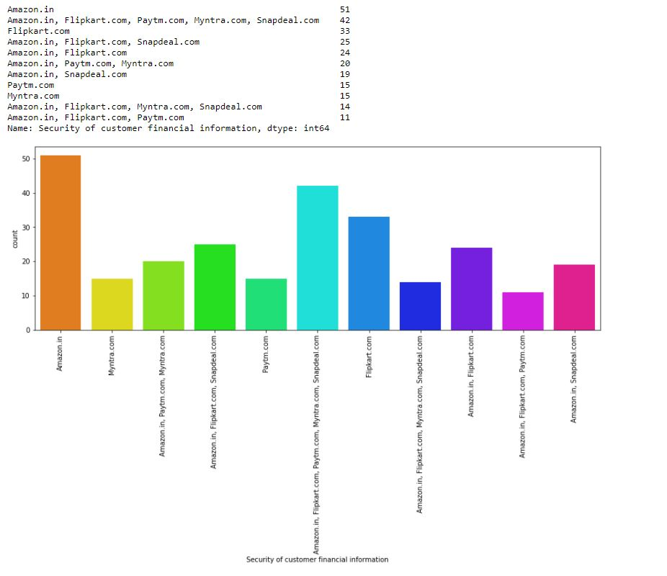

Slide 45
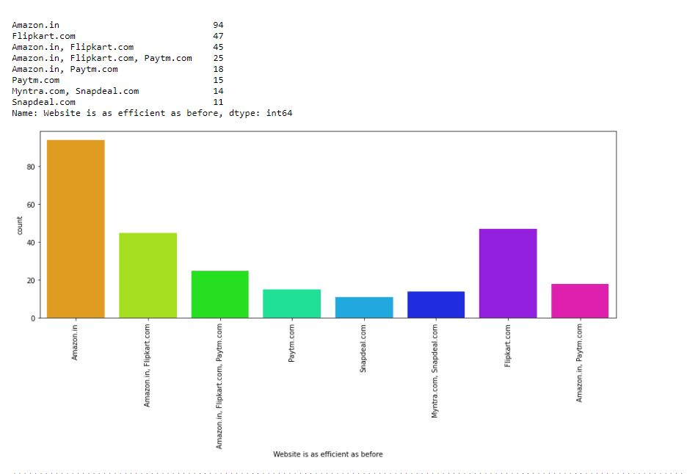

Slide 46
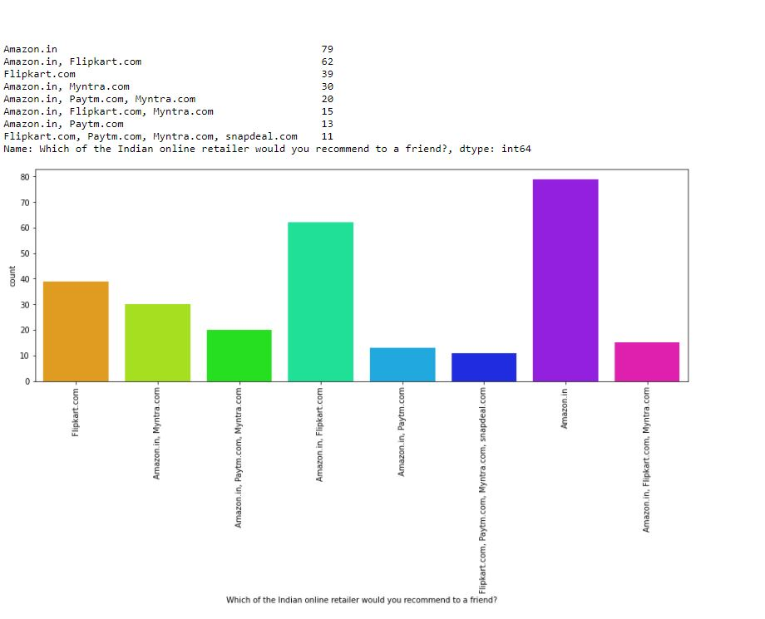

Slide 47
OBSERVATIONS ON CUSTOMER EXPERIENCE:
1. Most of the customers shopping on line have shopped majorly from the
following websites, Amazon. In, Flipkart.com, Snapdeal.com, paytm.com.
2. Amazon, flipkart, snapdeal, myntra seems to have easy to use website or
application.
3. Amazon.in and Flipkart.com has a visually appealing web-page layout.
4. Amazon.in and Flipkart.com has a wild variety of products on offers.
5. Amazon.in and Flipkart.com has complete and relevant description
information of products compared to all other websites.
6. Amazon. In, Flipkart.com, Snapdeal.com, paytm.com, myntra.com has fast
loading websites.
7. Amazon.in and Flipkart.com has the reliability of the customer.
8. Amazon.in, Flipkart.com has quickness towards completing the purchase.
9. Amazon. In, Flipkart.com, Snapdeal.com has availability of several
payment options.
10. Amazon.in and Flipkart.com has speedy order delivery.
11. According to customers the privacy and security of customer financial
information is maintained by Amazon.in and Flipkart.com.
12. Amazon. In, Flipkart.com, Snapdeal.com has a Perceived Trustworthiness.
13. Presence of online assistance through multi-channel is mostly provided by
Amazon.In, Flipkart.com, and Snapdeal.com.

Slide 48
14. Longer time to get logged in (promotion, sales period): Amazon.in,
Flipkart.com, Paytm.com.
15. Amazon.in, Flipkart.com, Myntra.com, Snapdeal.com takes longer time in
displaying graphics and photos.
16. Myntra.com, Paytm.com, snapdeal.com has a practice of late declaration of prices.
17. Myntra.com, Paytm.com, snapdeal.com, Flipkart.com has a longer page
loading time (promotion, sales period).
18. Amazon.in and snapdeal.com has limited mode of payment on most
products.
19. Paytm.com, snapdeal.com, Flipkart.com has a longer delivery period.
20. Amazon.in, Paytm.com has regular change in website/application design.
21. Amazon.in, Myntra.com, Snapdeal.com, Paytm.com has frequent disruption
when moving from one page to another.
22. Amazon.in and Flipkart.com Website are as efficient as before.
23. Amazon.in and Flipkart.com seems to be the most recommended Indian
online retailer website.

Slide 49
CONCLUSION :
The purpose of this study is to understand the influence of utilitarian
values, hedonic values, customer experience and perceived risk on Ecommerce customer satisfaction in India.
The analysis shows that the Utilitarian Value significantly influences
Customer Satisfaction, meaning that the level of Utilitarian Value of ecommerce customers will affect the level of Customer Satisfaction. In
other words, the better (higher) Utilitarian Value given by e-commerce
products will lead to satisfaction with customers.
Hedonic Value significantly influences Customer Satisfaction, meaning that the high and low Hedonic Value of e-commerce customers will affect the level of Customer Satisfaction. In other words, the higher the Hedonic Value given by e-commerce products will lead to the satisfaction of ecommerce customers.

Slide 50
The following factors should be considered by the E-commerce websites to improve the customer satisfaction:
1. Utilitarian Value
•Product offerings
•Product information
•Monetary savings
•Convenience
2. Hedonic Value
•Adventure Shopping
•Social Shopping
•Gratification Shopping
•Idea Shopping
•Role Shopping
•Value Shopping
3. Social Value
•Feel acceptable
•Good impression
•I am perceived
•Social approval

Slide 51
4. Perceived Risk
•Financial Risk
•Functional Risk
•Physical Risk
•Psychological Risk
•Social Risk
•Temporal Risk
5. Customer Satisfaction
•Purchasing Experience
•Site Selection

Slide 52
On the basis of these factors we could see that,
1. Amazon.in
2. Flipkart.com
are doing great in their performance on customer satisfaction and retention.

Slide 53
THANK YOU

